Slide 1

CoNCURRENT REACT
Andrew Barbour

Slide 2
Concurrent React
Introduced in React 18. Some features like Suspense in React 17.
An update to React’s core rendering phase model that makes rendering interruptible
Allows the UI to respond immediately to user input even while in the middle of rendering large portions of the application to create a fluid, natural user experience
No longer any Concurrent Mode in React 18. Opt in to concurrent features when needed.
Notes:
Note: “React Suspense” sometime used interchangeably with Concurrent React, but “concurrent React” the current official React terminology.
React Rendering Phase (Background)
https://reactjs.org/docs/reconciliation.html
https://kentcdodds.com/blog/fix-the-slow-render-before-you-fix-the-re-render
3 Phases in React Rendering Model: Render Phase -> Reconcilation Phase -> Commit Phase
The "render" phase: create React elements React.createElement
The "reconciliation" phase: compare previous elements with the new ones
The "commit" phase: update the DOM (if needed).

Slide 3
Concurrent vs. Non-Current React
React (Non-Concurrent, Default)
Updates are rendered in a single, uninterruptible and synchronous render phase that nothing can interrupt until the user can see it on the screen
Concurrent React Features
Prepares multiple screens in the background without blocking the main rendering thread so that React can start rendering, pause, resume, and abandon UI updates
Notes:
Non-current default even in React 18. Must opt in to use Concurrent React features.
Brings all the benefits of multi-threaded, non-blocking, concurrent rendering to React applications, from prioritizing UI updates to performance optimization to enhanced UI interactivity

Slide 4
Concurrent React Features
Code Splitting/Lazy Loading (17/18)
Suspense (17/18)
Transitions (18)
Offscreen (In Development)
Server Components (In Development)
Notes:
Concurrent React is a rapidly evolving development focus of the React team with many features still to come
Offscreen: when a user tabs away from a screen and back, the offscreen component restores the previous screen in the same state it was in before.

Slide 5
Suspense
A declarative API for specifying the loading state for part of a component tree to display while waiting for part of the UI to render
Common use case: a loading spinner fallback to display while lazy loading a component with React.lazy through code splitting/dynamic imports
Allows for the rest of the UI to remain interactive while waiting for the suspended component to load
Can nest suspending components and coordinate more complex suspending patterns with SuspenseList
Notes:
Lazy loading components requires that there’s a <React.Suspense> component higher in the rendering tree. React.Suspense lets you specify the loading indicator in case some components in the tree below it are not yet ready to render. See https://reactjs.org/docs/react-api.html#reactsuspense

Slide 6
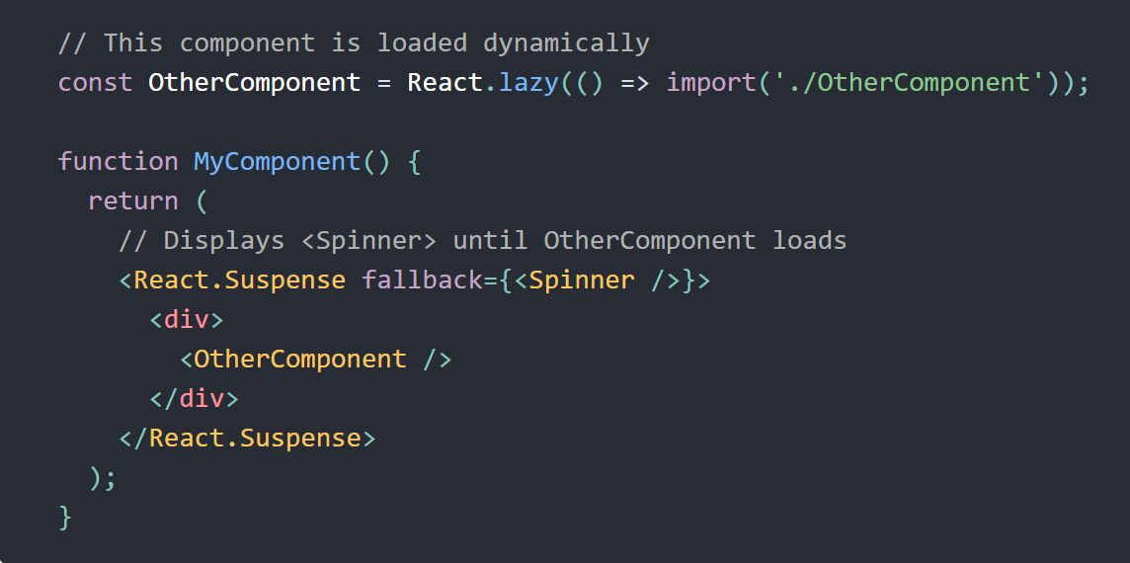

Slide 7
useTransition
Enables prioritizing urgent and non-urgent UI updates so that low priority updates yield to higher priority ones
Urgent updates: reflect direct interaction, like typing, clicking, pressing
Transition updates: transition the UI from one view to another like (re)-rendering a dropdown, listbox, or search results based on user input
Updates in a transition yield to more urgent updates such as clicks.
startTransition lets you mark updates in the provided callback as transitions
isPending indicates when a transition is active to show a pending state
Best combined with other concurrent features like Suspense
Notes:
Intention to match our intuition about how physical objects behave
Updates in a transition will not show a fallback for re-suspended content.

Slide 8
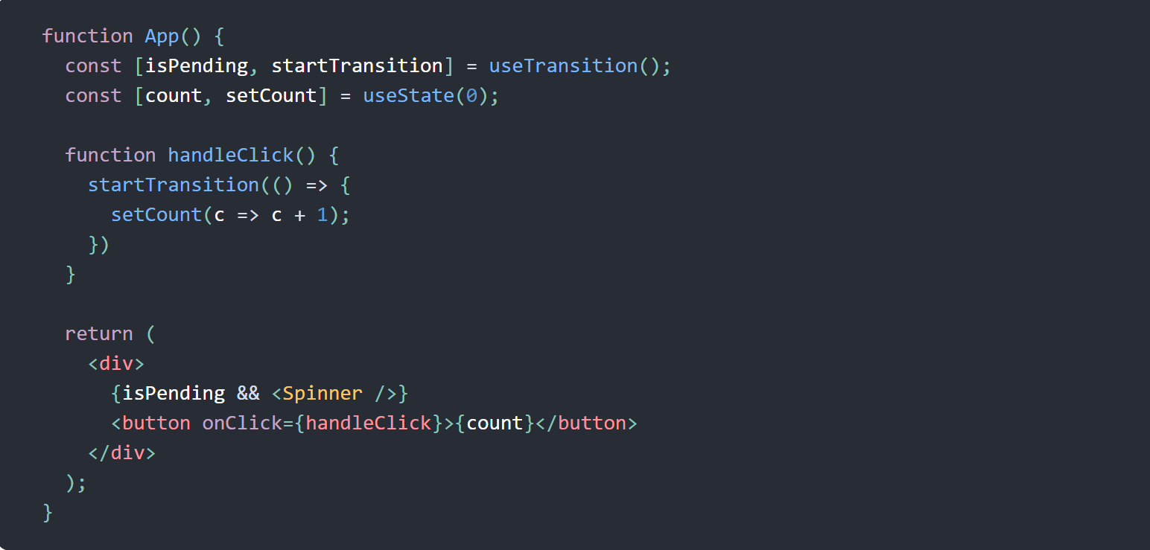

Slide 9
useDeferredValue
Accepts a value and returns a new copy of the value that will defer to more urgent updates.
If the current render is the result of an urgent update, like user input, React will return the previous value and then render the new value after the urgent render has completed.
Similar to debouncing or throttling to defer updates. React will work on the update as soon as other more urgent updates render (instead of waiting for an arbitrary amount of time)

Slide 10
Demos
Suspense
Viewer framework
SuspenseList
https://react-suspense.netlify.app/isolated/final/07.js (credit: Kent Dodds)
useTransition
Without concurrent features
With concurrent features (credit: Dmitri Pavlutin)

Slide 11
References
React 18 Concurrent Features
https://reactjs.org/blog/2022/03/29/react-v18.html
https://17.reactjs.org/docs/concurrent-mode-reference.html
React Suspense
https://reactjs.org/docs/react-api.html#reactsuspense
https://github.com/kentcdodds/react-suspense
Transitions
https://reactjs.org/docs/hooks-reference.html#usetransition
https://dmitripavlutin.com/react-usetransition/

